Slide 1
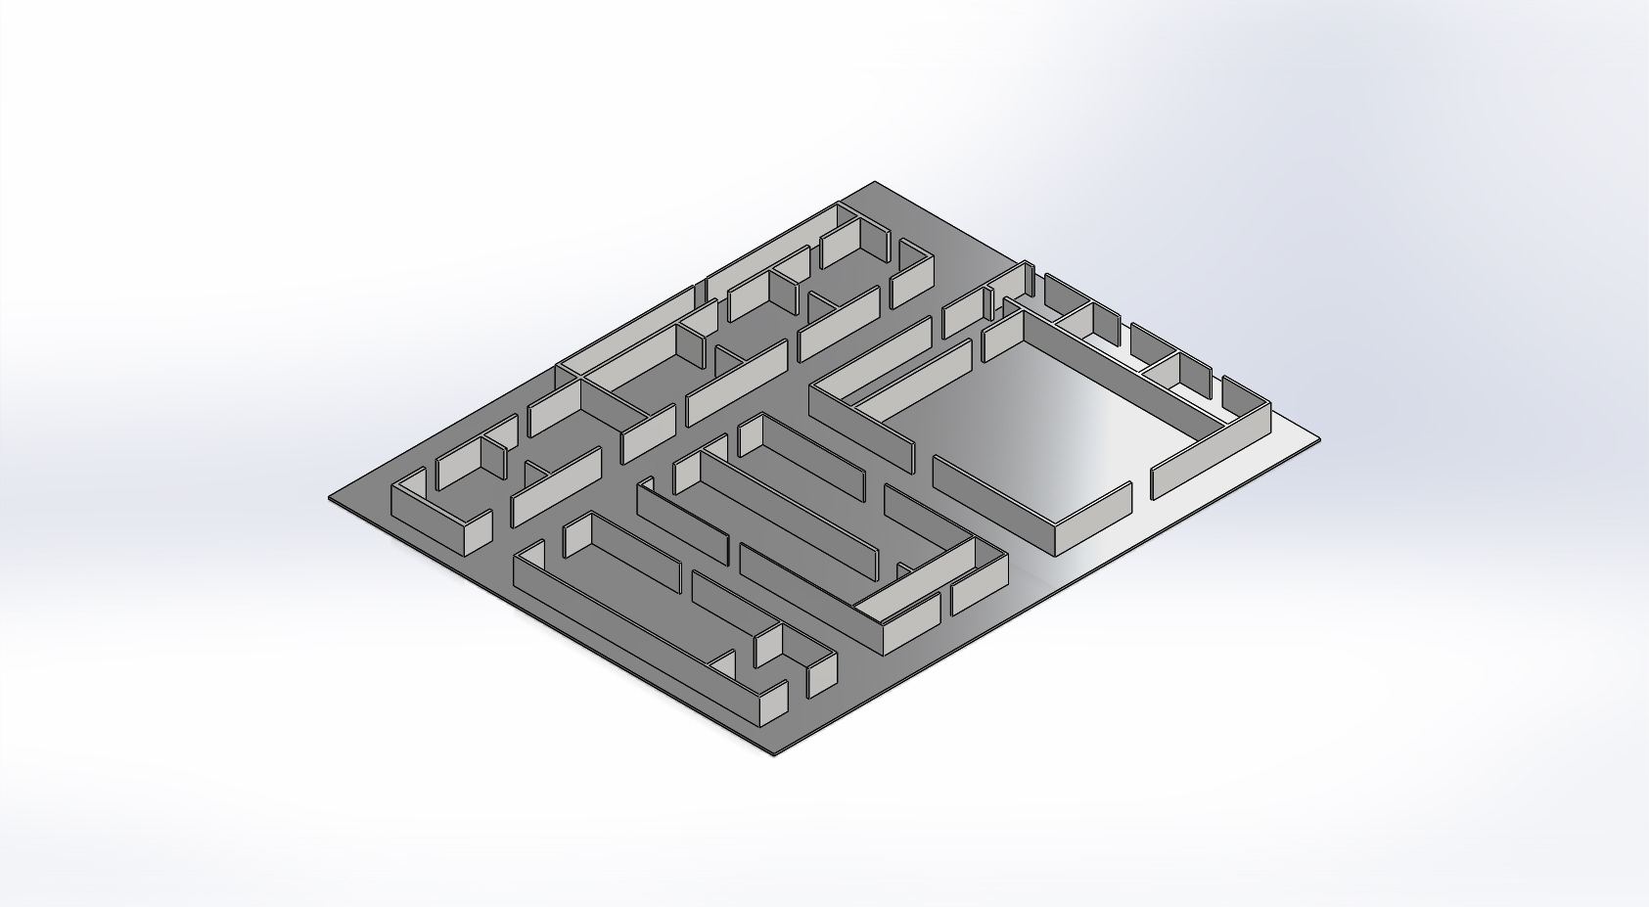
Waste Treatment
Cutting & Shaping Shop
Utility & Services
Drilling Shop
Welding Shop
Quality Control
Painting Shop
Warehouse
Drying Room
Assembly
Storage
Testing
Shipping
Fig: 3d Model of the Plant Layout

